Slide 1
Forsyth County Schools
International Baccalaureate Program
located at South Forsyth High School
IB Information Night
Notes:
Laura welcome & intro
Recommend talk about OOD briefly and emphasize why we think coming to SFHS as a FRESHMAN rather than waiting till JUNIOR year is wise.

Slide 2
International Baccalaureate
Assessment Pass Rate
Year | Number of diploma courses offered | Average number of diploma candidates
2001-2017 | 22 currently | 50-90
Diploma Pass Rate Comparison
Year | SFHS | Georgia | USA | World
2008-2017 | 89% | 54% | 67% | 78%
Notes:
Denney
Missing number under “Year” on Diploma Pass Rate *** not sure what you mean on “missing number”

Slide 3
AP or IB, that is the question…
AP
IB
High rigor
Quality point adjustment to GPA
College level coursework/ curriculum
Potential college credit
College recognition
of challenge
Interdisciplinary
Internally and externally assessed
Grading scale 1-7
4 is a “passing” score
Specific curriculum requirements across the disciplines
Develops whole student (CAS, EE, TOK)
Classes stand alone
Externally assessed
Grading scale 1-5
3 is a “passing” score
Large selection of classes
Can pick and choose subjects to take by preference
Notes:
Denney

Slide 4
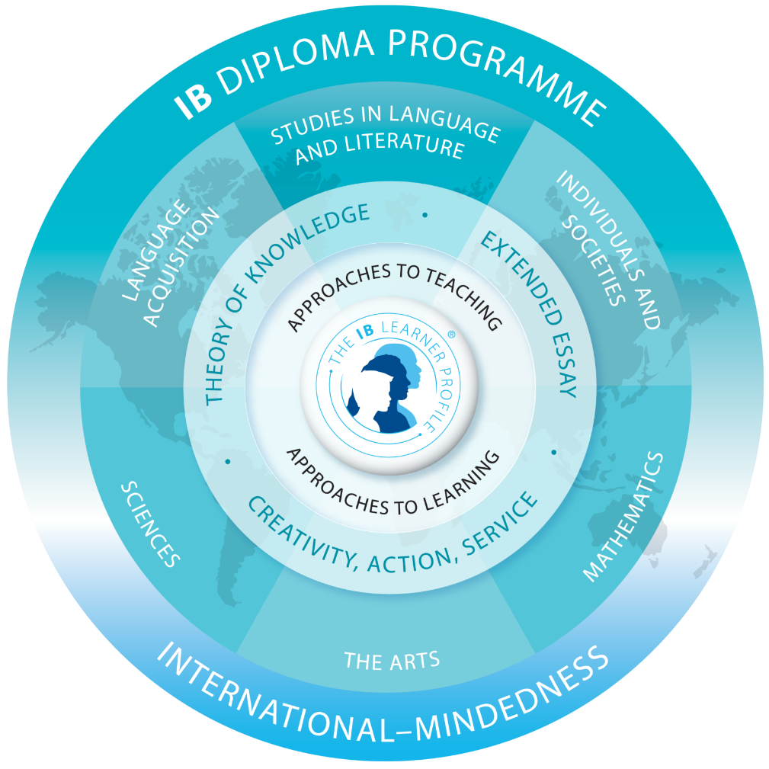
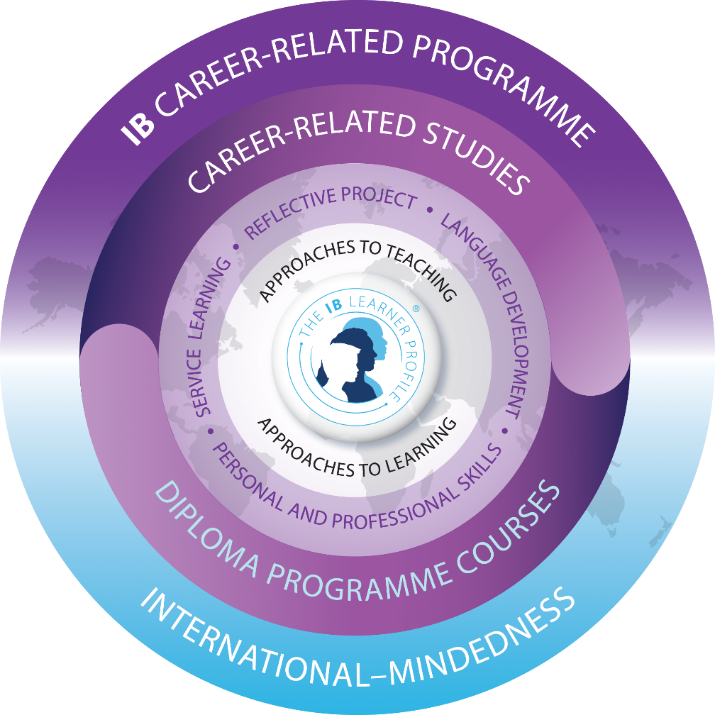
Two Programs
Whole Student
Approaches to Learning
Coursework
CORE
World Community
Diploma (DP)
Career-related (CP)
Notes:
Denney
Are these courses they can take to fulfill IB or is it to illustrate rigor?
***this is to illustrate two things: one being that AP courses are also possible while doing IB and the other that AP courses stand alone, while IB courses go with the whole student/program

Slide 5
IB Assessments
Internal Assessment
External Assessment
Graded internally by the classroom teacher
Random samples sent worldwide to IB examiners for moderation of scores
Some Oral
Some Written
Some Visual
Some Product
Some Lab
Timed, standardized IB exams given at SFHS in May
All exams sent world-wide to IB Examiners for external grading
Scores communicated to school and students in July after the exams
Notes:
Denney
Examples for 3 subjects – potentially Lit Oral Commentary & World Lit Paper, Spanish Orals and Written Assignment, Science designing an experiment, math quantitative, etc.
Emphasis on Real World Aspect
Worked on and graded by teacher, moderated by IBO
Emphasis on how STUDENT and TEACHER have control over this part of their final grade
It is Part of Final IB Grade award for potential college credit

Slide 6
Course Availability
Higher HL Courses
Standard SL Courses
Mathematics* (AP Calc AB),
Math Studies*,
Chemistry, History*,
Design Technology,
Environmental Systems,
English Language/Comp.*,
Foreign Languages*,
Business,
Psychology,
Computer Sciences,
Visual Arts, &
Music (can be taken with Advanced Band)
Mathematics (Calculus)
Biology
Physics
History
English Literature
Foreign Languages
Visual Arts
IB Curriculum
Required (CORE)
Theory of Knowledge (DP)
OR
Personal & Professional Skills (CP)
*can count for two-year course requirement for CP
Notes:
STUDENT Presentation
Emphasize choice of 3 higher levels, that this can be for humanities oriented students OR Math/Science nerds/geeks; students MUST do 3 or more Higher Level offerings that cover two years of coursework
Also emphasize the Wide variety of sciences, lang b, and elective subject options for Diploma Program

Slide 7
Diploma CORE
Career CORE
CAS (Creativity Action & Service)
Approximately 140 documented hours of student interaction within community
Extended Essay
3000-4000 word research paper on a topic of the students choice
Theory of Knowledge
Discussion oriented class that ties all the IB subject matter together with questions and arguments about “what is knowledge”?
SL (Service Learning)
Approximately 50 documented hours of student interaction within community
Reflective Project
3000 word research paper on an “ethical dilemma” within their pathway
Language Development
Student shows growth in a second language over the two years
Personal & Professional Skills
Discussion oriented class on soft skills business world wants; discusses ethics, leadership, teamwork and more
Notes:
Robinson/Fahey/Thompson
Talk about Whole Student aspect of the IB Diploma Program, how it goes beyond just book learning and teaches how to learn, how subjects connect together and the development of the learner profile.
TOK as glue to tie it all together and think about
EE as a deep study into a subject area of their choice, mentored over the process by our EE Coordinator and by a mentor in the field they are completing the EE in.

Slide 8
Coursework Required
Diploma
Career
6 Diploma Subjects
Three+ Higher Level (HL) = 2 year
Three- Standard Level (SL) = 1 year
2 Diploma Subjects
One+ Higher Level (HL) = 2 year
OR 2 year Standard Level Course*
One- Standard Level (SL) = 1 year
Required DP Subject Areas
Required DP Subject Areas
Math
Science
History
English
Foreign Language
6th Subject (Choices)
&
Theory of Knowledge
ANY two DP
&
Personal & Professional Skills
Plus
Career Pathway (both years)
Foreign Language (one year)
Notes:
Robinson/Fahey/Thompson
Talk about Whole Student aspect of the IB Diploma Program, how it goes beyond just book learning and teaches how to learn, how subjects connect together and the development of the learner profile.
TOK as glue to tie it all together and think about
EE as a deep study into a subject area of their choice, mentored over the process by our EE Coordinator and by a mentor in the field they are completing the EE in.

Slide 9
Whole Student
Diploma
Career
Extended Essay - (worked on junior & senior years with mentor)
C.A.S.- Creativity Activity & Service (~140 hours of reflections)
Reflective Project - (worked on junior & senior years with mentor & skill training in PPS course)
S.L. – Service Learning
(~50 hours of reflections)
Notes:
STUDENT presentation

Slide 10
Characteristics of IB Students
Motivated
Work Ethic
High Standards for themselves and their works
Good Homework Ethic
Organizational Skills
Positivee Attitude
Communication Skills
Written Expression
Reading Comprehension
Critical Thinking Skills
Acceptance of Criticism
Academically Responsible
Risk Takers
Principled
Inquiring
Independent
Communicators
Knowledgeable
Caring
Intense
Hard Work Ethic
Time Management Skills
Highly Motivated to Succeed
Notes:
Denney
Emphasize the two aspects: that we are DEVELOPING these characteristics in students in the program, particularly risk taking, communication/presentation and time management and inquiry, but that students interested in the program need a strong work ethic coming in.

Slide 11
Preparing for IB
Recommended Coursework
9th Grade: FreshmanYear
10th Grade: Sophomore Year
Honors 9th gr. Literature
Honors Science (Biology)
Foreign Language (continue)
Appropriate Math Pathway
AP Human Geography
PE/Health
Elective
Honors 10th gr. Literature
Honors Science (Chemistry)
Foreign Language (continue)
Appropriate Math Pathway
AP World History
Elective
Elective
Either Program – TWO+ “Honors-level or higher” courses each year
Notes:
Denney

Slide 12
Typical Career-Related Schedule
JUNIORS |  |  | SENIORS
AP Amer.Lit |  | SL | IB Lang. & Lit. SL
Accel. Precalculus |  | HL | Calculus
Spanish IV |  | HL | Graduation Requirement OR Elective
Any Science |  |  | Graduation Requirement OR Elective
Graduation Requirement OR Elective |  |  | IB Business SL
Marketing Path Course #3 |  |  | Continue Market. Path: Internship, Mentorship, Research, etc.
Government | Personal & Professional Skills |  |  | Economics
Exam
Exam
key
Core
IB Required
Other
Notes:
Example schedules:
Denney
Emphasize these are just EXAMPLES of one possible schedule and that students may not be able to take every course depending on the master schedule and registration numbers. That there are many possibilities of study.

Slide 13
Typical Humanities Schedule
JUNIORS |  |  | SENIORS
IB History of Americas/APUSHistory |  | HL | IB 20th Century Topics HL
IB English HL Year 1 |  | HL | IB English HL Year 2
Spanish IV or AP Spanish |  | HL | IB Spanish HL
Math 3 |  |  | IB Math Studies SL
IB Psychology SL |  |  | IB Chemistry SL
Graduation Requirement OR Elective |  |  | Graduation Requirement OR Elective
Government | Theory of Knowledge |  |  | Economics
Exam
Exam
Exam
Exam
Exam
Exam
key
HL
SL
Other
Notes:
Example schedules:
Denney
Emphasize these are just EXAMPLES of one possible schedule and that students may not be able to take every course depending on the master schedule and registration numbers. That there are many possibilities of study.

Slide 14
Typical Heavy Math/Humanities Combo
JUNIORS |  |  | SENIORS
AP Calculus AB/BC |  |  | IB Mathematics HL
 |  |  | 6th Subject: IB Physics SL
IB History of Americas/APUSHistory |  |  | IB 20th Century Topics HL
IB English HL Year 1 |  |  | IB English HL Year 2
IB Chemistry SL |  |  | Graduation Requirement OR Elective
Spanish IV or AP Spanish |  |  | IB Spanish SL
Government | Theory of Knowledge |  |  | Economics
Exam
Exam
Exam
Exam
Exam
Exam
key
HL
SL
Other
Notes:
Example schedules:
Denney

Slide 15
Typical Heavy Math/Science Schedule
JUNIORS |  |  | SENIORS
AP Calculus AB/BC |  |  | IB Mathematics HL
 |  |  | 6th Subject: IB Chemistry SL
IB History of Americas/APUS History |  |  | IB 20th Century Topics HL
AP Language Composition |  |  | IB English Land & Lit SL
IB Biology HL Year 1 |  |  | IB Biology HL Year 2
Spanish IV or AP Spanish |  |  | IB Spanish SL
Government | Theory of Knowledge |  |  | Economics
Exam
Exam
Exam
Exam
Exam
Exam
key
HL
SL
Other
Notes:
Example schedules:
Denney

Slide 16
PAYOFF: College Course Credits
Scores of 4+ (IB scale is 1-7)
can earn credit
depending on college/university
Colleges are looking at the following characteristics when they evaluate candidates for admission to their campus:
Rigor of coursework undertaken by the prospective candidate
SAT & ACT Test scores
GPA*
Class Rank
Application Essay
Work/School Activities
PLUS: A number of states offer 24 hours of college credit to students who receive the IB Diploma including: Georgia, Florida, Texas, & California
Notes:
Denney
Emphasis on schools beginning to see IB Diploma students as having gone beyond what the typical AP high school student has accomplished.
Discuss impact of IB Scores on both getting in, and the ability to either finish early, get into higher content coursework earlier in college, and/or double majoring in their university studies.
If they ask:
We typically lose 5-10% of the junior class prior to entry into 12th grade from the full Diploma Program for various reasons, most typically deal with poor homework work ethic affecting student grades.

Slide 17
IB Students Graduate from College at Higher Rates
The 2011 study of IB students’ experiences after high school found that IB students graduated from college at higher rates, with 81% of IB students graduating within 6 years of enrolling full-time at a 4-year institution, compared to the national average of 57%.
January 1, 2012
Notes:
Denney
Emphasize that this is an outside study that shows similar comparison to AP study.
In the 2011 SRI International study of the post-secondary outcomes for nearly 25,000 Diploma alumni, researchers found that at institutions with high IB enrollments, graduation rates for IB students were generally higher than the institutional average. Overall, 81% of IB students graduated within 6 years of enrolling full-time at a 4-year institution, compared to the national average of 57%.
A summary of the SRI International post-secondary study be found here:
http://www.ibo.org/research/policy/programmevalidation/diploma/documents/PostsecondaryenrollmentpatternsofIBcertificateanddiplomacandidates-USdomestic-2011.pdf

Slide 18
University or College | IB Students Acceptance Rate | Total Population Acceptance Rate | IB Students vs Total Population
University of Florida | 82% | 42% | +40%
Georgia Institute of Technology | 81% | 59% | +22%
Brown University | 18% | 9% | +9%
Stanford University | 15% | 7% | +8%
Columbia University | 13% | 9% | +4%
University of California - Berkeley | 58% | 26% | +32%
Harvard University | 10% | 7% | +3%
Davidson | 64% | 34% | +30%
Emory University | 78% | 42% | +36%
University of Miami | 72% | 30% | +42%
Source: IBDP Graduate Destinations Survey 2011/12 conducted by i-graduate International Insight
Strictly copyright © IGI Services 2011
January 1, 2012
Notes:
Denney
Sample acceptacnce rates. Note the difference between total population and IB students
The IB surveyed all IB world schools in the United States registering students for Diploma exams in May 2011 and all US 12th graders registered for exams about their college application process. According to student self-reports, IB students are admitted to college and universities at higher rates than the general population.
This slide shows the Universities most commonly applied to by US Diploma candidates, and demonstrates that IB students have higher acceptance rates than the average acceptance rates for the university.

Slide 19
University or College | IB Students Acceptance Rate | Total Population Acceptance Rate | IB Students vs Total Population
Cornell University | 31% | 18% | +13%
Duke University | 28% | 16% | +12%
University of Pennsylvania | 24% | 14% | +10%
Yale University | 18% | 7% | +11%
University of Georgia | 95% | 65% | +30%
Boston University | 70% | 58% | +12%
University of California - Los Angeles | 48% | 23% | +25%
University of Virginia | 64% | 32% | +32%
UNC Chapel Hill | 63% | 32% | +31%
Princeton University | 16% | 8% | +8%
Source: IBDP Graduate Destinations Survey 2011/12 conducted by i-graduate International Insight
Strictly copyright © IGI Services 2011
January 1, 2012
Notes:
Denney
Sample acceptacnce rates. Note the difference between total population and IB students
The IB surveyed all IB world schools in the United States registering students for Diploma exams in May 2011 and all US 12th graders registered for exams about their college application process. According to student self-reports, IB students are admitted to college and universities at higher rates than the general population.
This slide shows the Universities most commonly applied to by US Diploma Candidates, and demonstrates that IB students have higher acceptance rates than the average acceptance rates for the university.

Slide 20
Some of the Colleges SFHS IB Students Have Attended
Amherst | Duke University | Mercer University | University of California – Los Angeles (UCLA)
Auburn University | Elon | New York University | University of Chicago
Baylor University | Emory | North Carolina State | University of Florida
Berry | Flagler | Notre Dame | University of Georgia
Boston College | Florida State | Oglethorpe | University of Miami (FL)
Boston University | Furman | Oregon | University of North Carolina – Chapel Hill
Bowdoin | George Washington | Oxford (at Emory) | University of North Carolina – Wilmington
Brigham Young | Georgia Institute of Technology | Presbyterian | University of South Carolina
Clemson University | Georgia Southern | Randolph-Macon | University of Virginia
College of Charleston | Georgia State University | Rhode Island | Vanderbilt
Converse | Harding | Tulane | Washington College
Cornell University | Illinois Kennesaw State | Universite de Nantes | Wheaton
Davidson | Massachusetts Institute of Technology (MIT) | University of Alabama-Birmingham | Wofford
Notes:
Denney/Thompson/STUDENT Presentation

Slide 21
A Note on $ Costs
Diploma Program Costs (typical)
Career Program Costs (typical)
Junior Year (typically 2x exams):
$175 Registration for CORE
$122 for one exam
$122 for second exam
$419 total
Senior Year (typically 4x exams):
$122 for one exam
$122 for one exam
$122 for one exam
$122 for second exam
$488 total
TOTAL 2 Years = $907
To note: these are subject to change. There is also a yearly admin fee of $30
Junior Year (typically 1x exams):
$175 Registration for CORE
$122 for one exam
$297 total
Senior Year (typically 4x exams):
$122 for one exam
$122 total
TOTAL 2 Years = $419
Both Programs (other)
Yearly IB Retreat:
$150-175 per year
Senior Year Graduation Banquet:
$25-$45 per plate
Notes:
Title: Financial Obligiations
Need to add Administration Fee
Make a note “subject to change”
Retreat?

Slide 22
What the Students Say
“Learn how to learn”
“You care about what you are learning.”
“Confidence builder”
“Fun studying – not alone but with peers in the same boat as you”
“There is a learning curve.”
“Is time for friends, is time for other things”
“It’s a program, not individual classes.”
“Sense of community: classmates, teachers, ancestors”
“Not just a humanities program”
“Different way of thinking”
“Teaches responsibility of an adult in high school (not college wakeup call)”
“All assignments are, at first, scary but they are doable; you are taught how.”
Notes:
STUDENT Presentation
Please bring the students up here, introduce themselves, indicate which school(s) they are hoping to be accepted to, etc.. I will send you a copy of the questions they were asked to know answers to.
Make sure Students talk, answer questions with Emphasis on:
Family Esprit de corps
Variety of Colleges
They do have social time
Many different activities outside class
Well rounded nature
Challenge – Joy of learning

Slide 23
IB Course Preparation: 9th & 10 grade
Factors to consider when you make registration decisions for a student’s schedule. Key word: “Balance”
9th grade and 10th grade schedule must reflect at least two Honor level courses (refer to slide 2)
• Course Expectations and Workload
• Including Total Schedule Impact
• Extracurricular (School) Activities
• Sports, Clubs/Organizations
• Family/Social Considerations
• Work? Friends? Downtime?
• Church and Community Obligations
• Volunteerism and other involvements?
Notes:
Tracy Verrigni or Laura Wilson

Slide 24
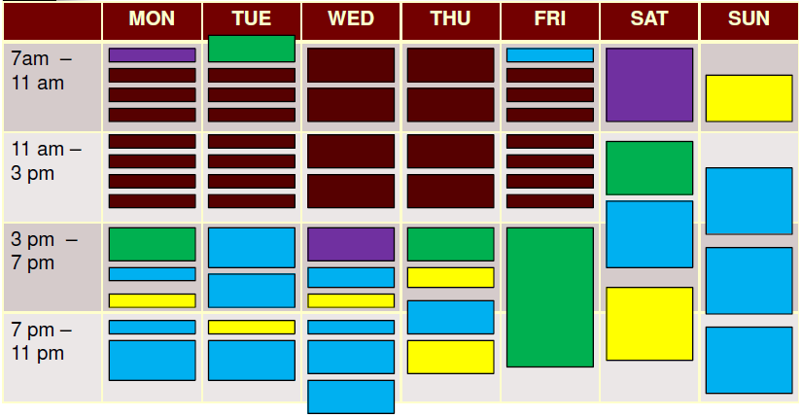
Sample Student Week’s Schedule
Notes:
Tracy Verrigni or Laura Wilson
Should this be moved to be included with course info.? ODD requirements?

Slide 25
Provide link????
Out of District Requests
OOD requests for rising 9th graders to attend South Forsyth High School will not be accepted for the 2018-2019 school year. Students interested in the International Baccalaureate Program are encouraged to make application in the 2019-2020 school year. Any student attending a school out-of-district must provide their own transportation.
South Forsyth HS students who are currently 10th graders and on track for entering the IB program during the 2018-2019 school year may stay at South Forsyth HS, contingent upon schedule/course work, by completing an OOD form. South Forsyth HS administration will verify which students are considered to be “on track”. Please use link: http://www.forsyth.k12.ga.us .
OOD requests must be submitted online by January 19th, 2018. The district will notify you regarding your application via email in February. Please do not contact SFHS regarding OOD requests. This will be handled through the County Office.
Students who request OOD for the International Baccalaureate Program at SFHS will only be considered if they meet the prerequisite criteria.
Out of District Details
Notes:
Tracy Verrigni or Laura Wilson
Not sure we need the teacher rec. info here. Focus should be on criteria for OOD???
***Admin wanted to add that I believe two years back b/c of issues with parents waiving over teacher recs. Still have that problem so should at least mention it probably. Will delete if you really want off

Slide 26
For More Information
Kevin Denney, IB Coordinator
kdenney@forsyth.k12.ga.us
770-781-2264 ext. 101120
School Website: www.forsyth.k12.ga.us/sfhs/site/default.asp
Click the Academics tab, then Advanced Studies, then International Baccalaureate
You can also get more information about IB at www.ibo.org.
Notes:
Tracy Verrigni
Change your extension? Change OOD deadline to 1/31/2017
Note: Please do not contact SFHS regarding OOD requests. This will be handled through the County Office?

